Slide 1




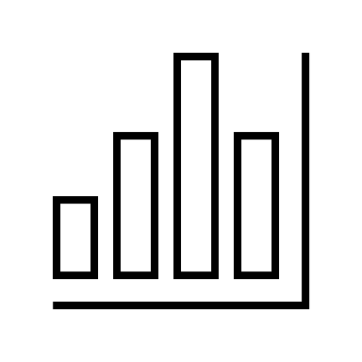
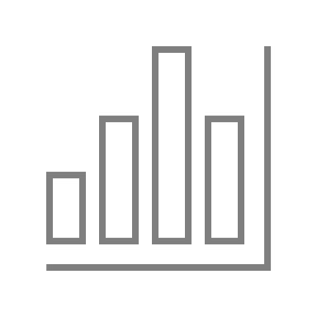







Wine Quality Classifier
Analyzing and predicting the quality of wine based on its attributes and reviews
Objective: To classify the quality of wine into two categories: “high” and “poor”
Data source: Obtained from https://www.wine.com/
Methods: Data preprocessing, data visualization, and machine learning
Results: Best-performing model is Logistic Regression with an accuracy of 83.33%

Slide 2

Preparing the Data
Cleaning and filtering the data to remove null values and outliers
Cleaned reviews column by removing punctuation and converting to lowercase
Removed rows with null values in reviews, 0 value in rating or abv, or a value less than or equal to 8 in rating_count
Removed rows with non-numeric year, or year greater than or equal to 2021, or less than or equal to 2000
Converted price column to integer and removed rows with value greater than or equal to 250
Converted rating column to float
Removed rows with varietal or origin that didn't appear in at least three other rows Removed duplicate rows based on product_name
Added varietal_code and origin_code columns to DataFrame

Slide 3
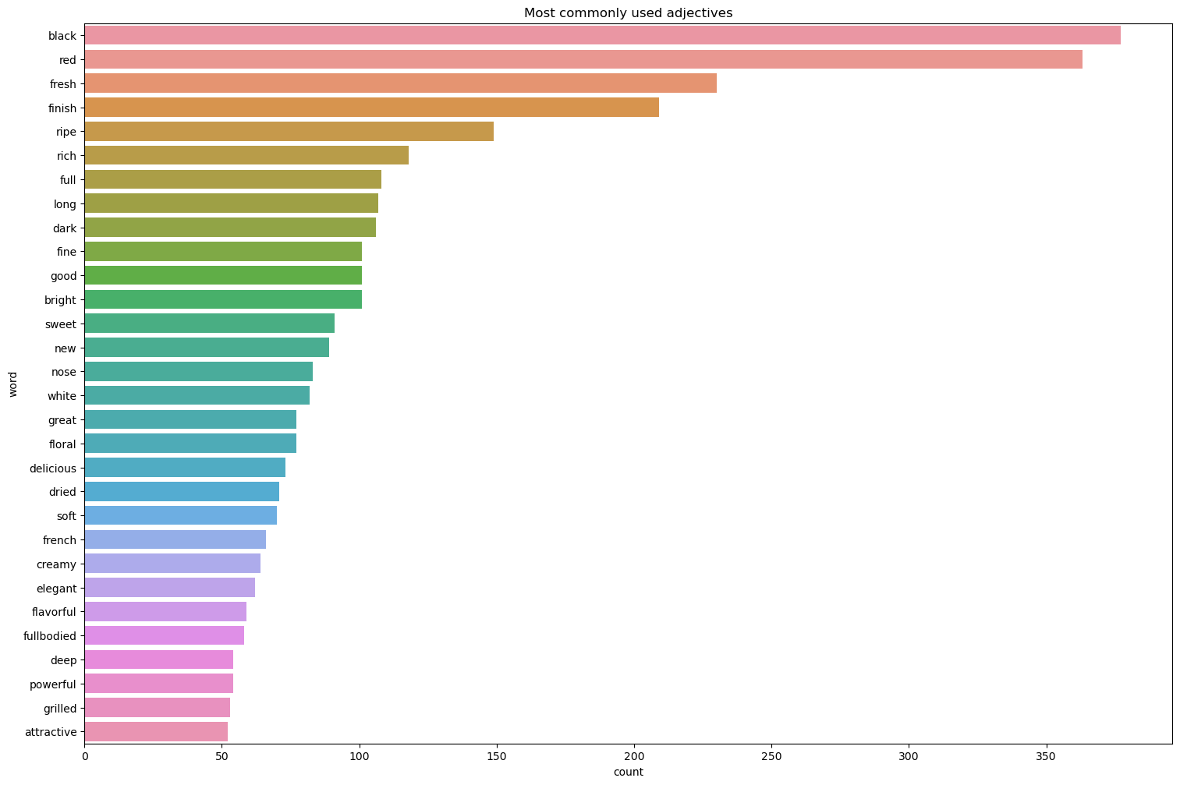
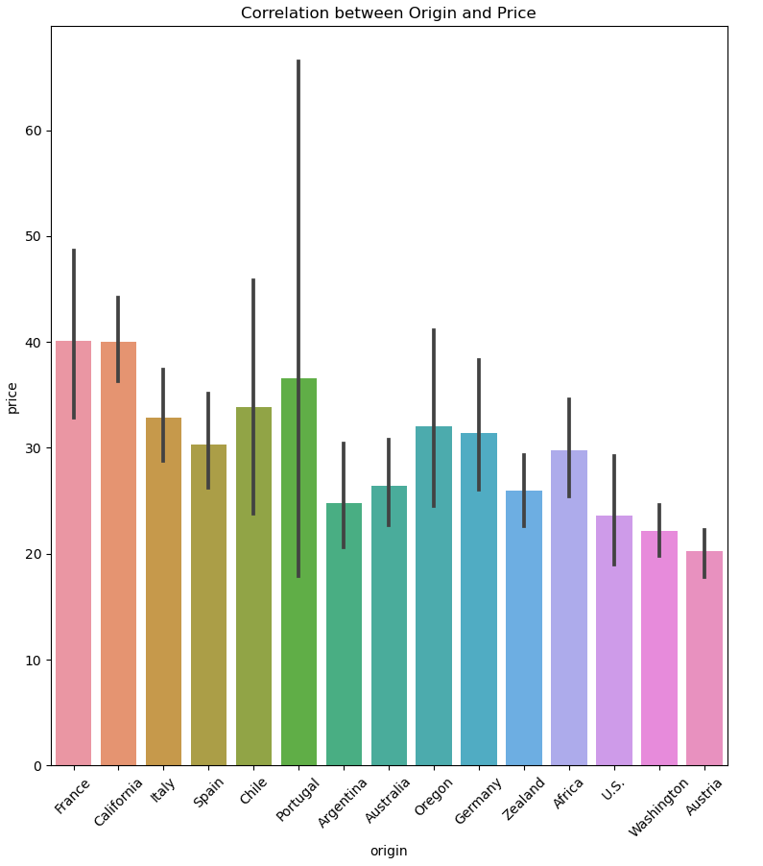
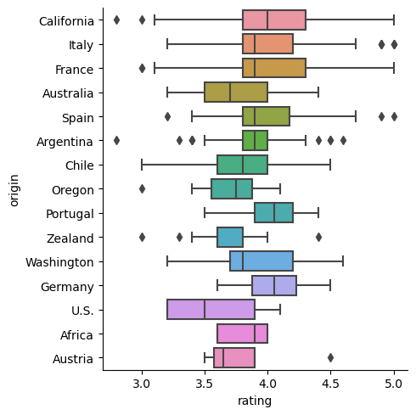
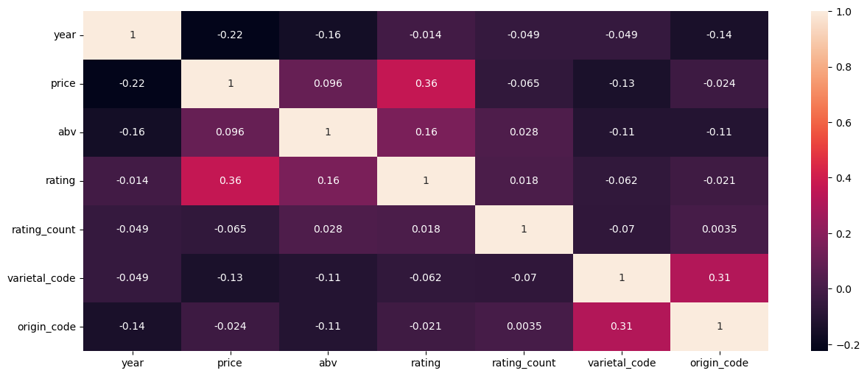
Understanding the Data
Analyzing the relationships between different columns in the data
Created a heatmap of the correlations between different columns in the DataFrame
Created a line plot showing the average price of wine by year
Created a scatter plot showing the correlation between rating and rating count
Created a bar plot showing the most common adjectives used in the reviews
Created bar plots and strip plots to show the correlation between price, rating, and origin
Created scatter plots to show the correlation between price, rating, and year for different wine origins

Slide 4
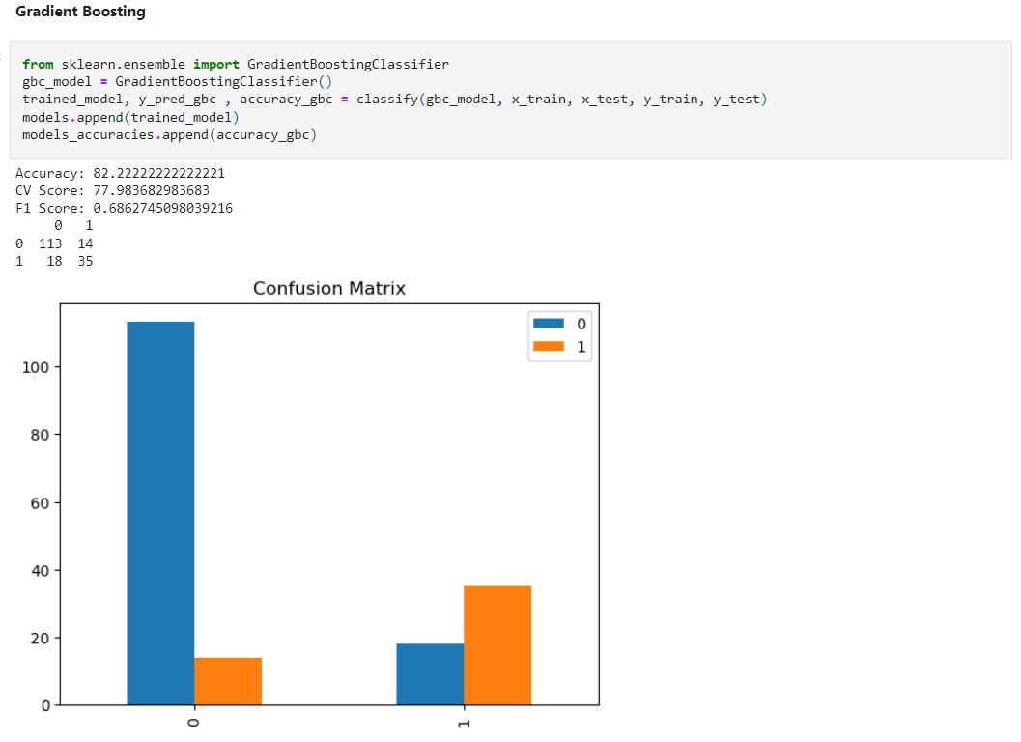
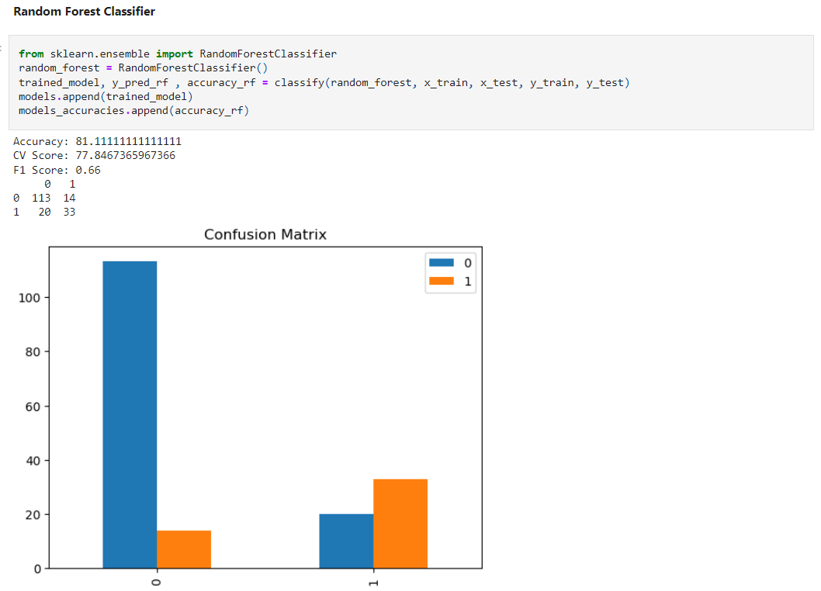
Classifying the Quality of Wine
Training and evaluating different machine learning models
Trained and evaluated several machine learning models including:
Logistic Regression
Decision Tree
Random Forest
Extra Trees
AdaBoost
Gradient Boosting
LightGBM
MLP
SVC
Naive
Bayes
Evaluated the performance of each model using accuracy and cross-validation score
Compared the performance of different models

Slide 5
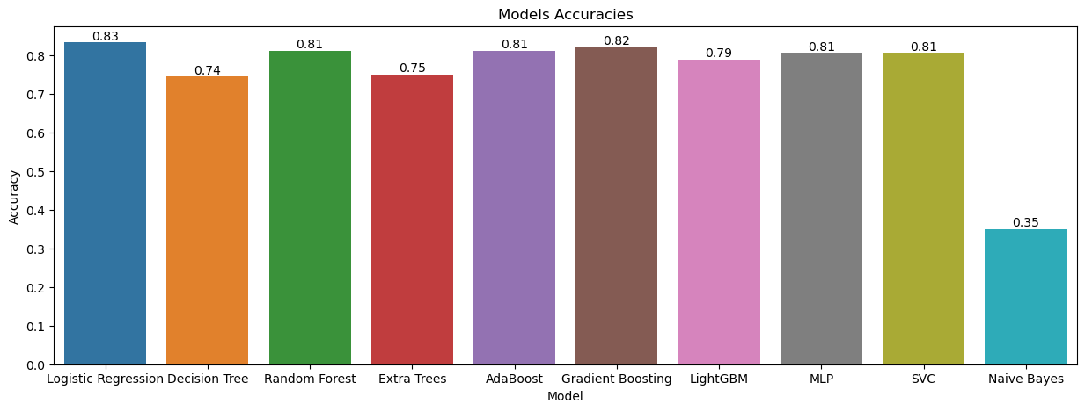
The Best Performing Model
Highlighting the best-performing model and its performance metrics
The best-performing model is Logistic Regression With an accuracy of 83.33%, a cross-validation score of 80.35%, and a f1 score of 66.66%
The model has been selected based on the highest accuracy and cross-validation score
The f1 score is also good, indicating that the model is good at predicting both classes

Slide 6
Conclusion
After analyzing and visualizing the data, we found some interesting insights about the wine industry. We also applied several machine learning techniques to predict the quality of a wine based on its characteristics and reviews. Out of the various models we tried, Logistic Regression performed the best with an accuracy of 83%. However, it is important to note that all the models had a relatively high accuracy, indicating that there are strong correlations between the features and the target variable.

